Slide 1

Komodo systems
You can’t manage what you can’t see

Slide 2
Understanding and using the Komodo Dashboard
Your Komodo Eyes are monitoring your airspace on a regular basis. We’ll discuss how to read and interpret the data we’re gathering

Slide 3
Agenda
1
Komodo Eye Configuration
4
Problem Identification
Walk through configuration of new and existing Komodo Eyes
Where you can look to find problems and work to resolve them
Status of Organization Wi-Fi
Periodic Reporting
2
5
How to review overall performance across your company
Review of historical and periodic reporting options
Status of Building/Room Wi-Fi
6
FAQ
3
How to review Wi-Fi performance in specific areas
Common implementation and configuration issues addressed

Slide 4
1
Device Configuration
Walk through configuration of new and existing Komodo Eyes

Slide 5
Wizard Device Configuration
In order to test, a Komodo Eye needs:
  Physical Test Location – Noting the building, floor, and room from which the device is testing will appropriately document and categorize test results
  Target SSID(s) – One Eye can test up to three unique SSIDs per test cycle
    Hidden SSIDs are marked by a * - once registered, they will be listed by their SSID name
  Target AP(s) – Komodo Eyes associate to the same AP (by radio MAC address) each test cycle
1

Slide 6
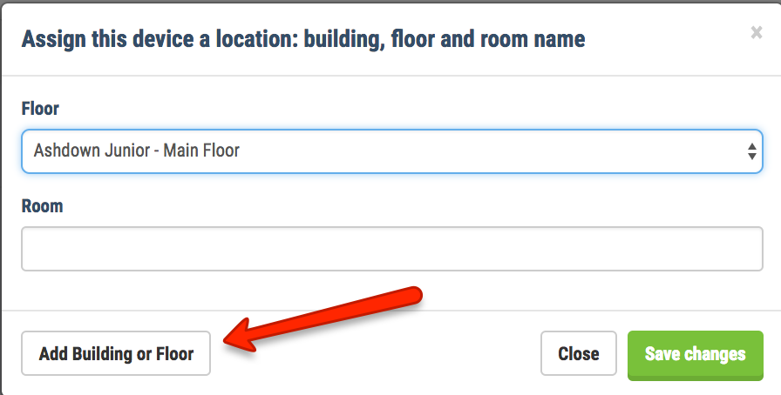
Wizard Device Configuration
Step 1: Location Assignment
  Only devices that are ’heart beating’ with the Komodo servers will be configurable
1

Slide 7
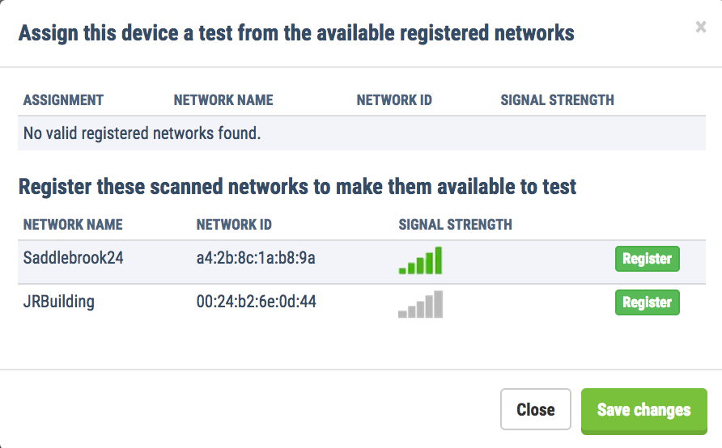
Wizard device configuration
Step 2: SSID Assignment
  Select a pre-registered SSID or register a new SSID
  The wizard will select the one closest AP and create the test assignment. See manual device configuration for further customization
1

Slide 8
Wizard device configuration
Step 3: Coverage Matrix
  The Eye targets specific APs for testing, but may ‘see’ others in the airspace. Step 3 shows you all APs that are not targeted in a test assignment
1

Slide 9
Manual device configuration
The Komodo Dashboard and Eyes have a ‘brain/drone’ relationship
Anytime configuration changes are made in the panel, the Eye must sync before changes are written to disk
Configuration changes are identified during heartbeat and pushed to device
Recommend waiting 2-3 minutes after configuration changes for device to sync
1

Slide 10
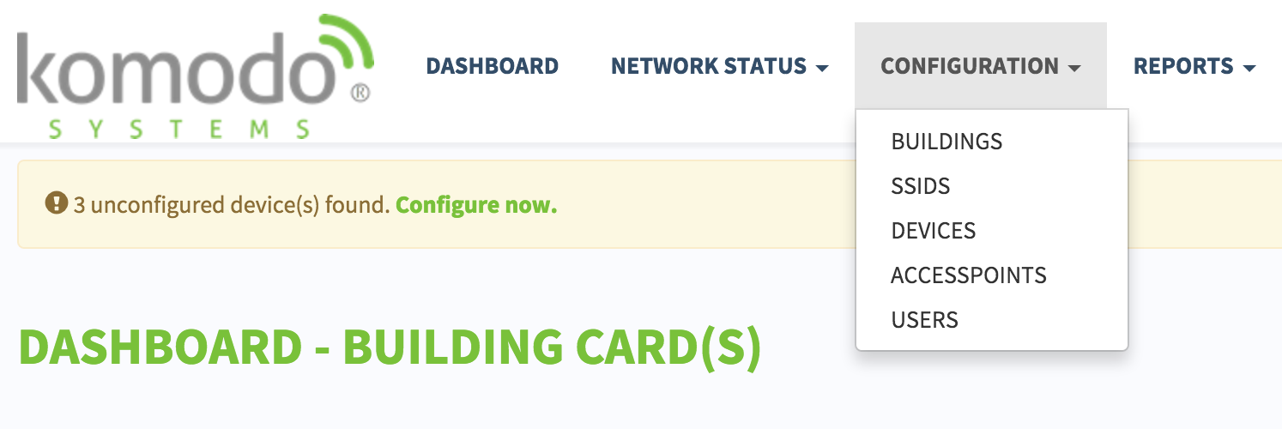
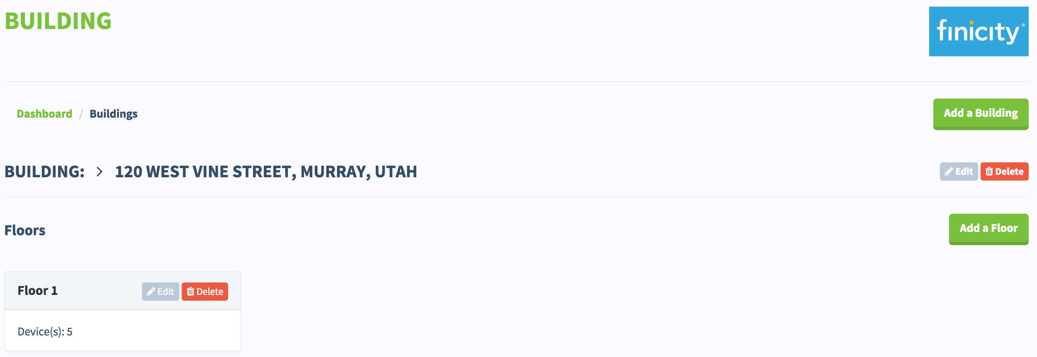
Manual Device configuration
Select Buildings within the configuration menu
Select Edit or Add within the Building or Floor section to make updates
Once buildings and floors exist, devices can be assigned and configured
1

Slide 11
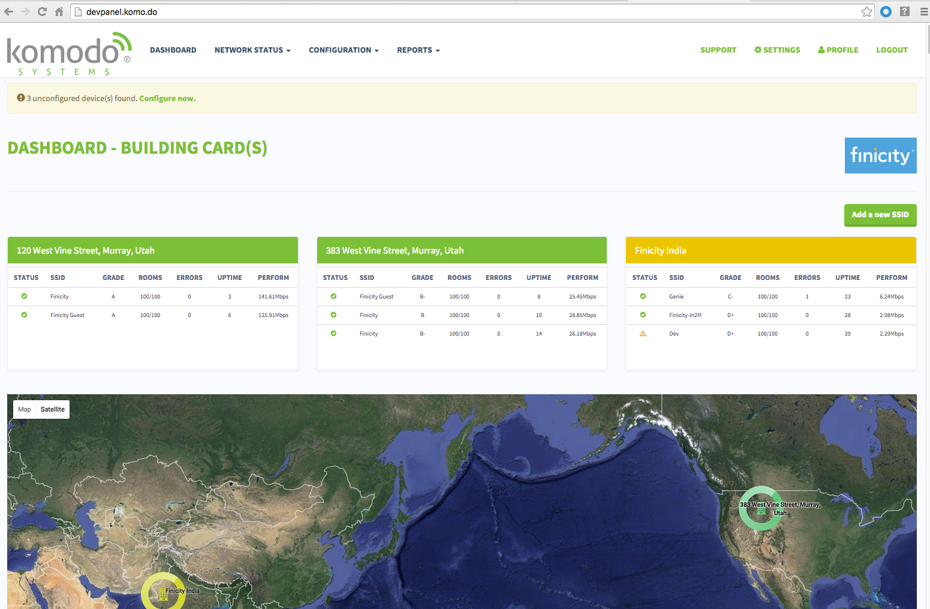
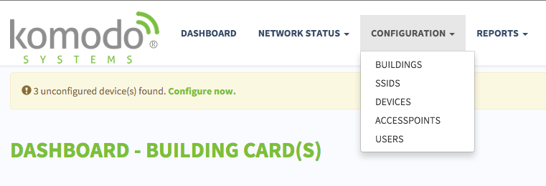
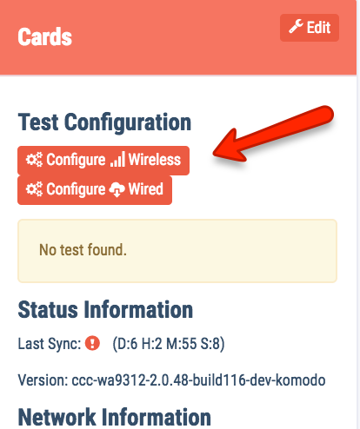
Manual device configuration
Step 1: Click ‘Configure Now’ for new devices, or ‘Devices’ for reconfiguration
Step 2: Click Edit on device card to update assigned building, floor, and room name
Step 3: Click Config Wireless to update test assignments
1

Slide 12
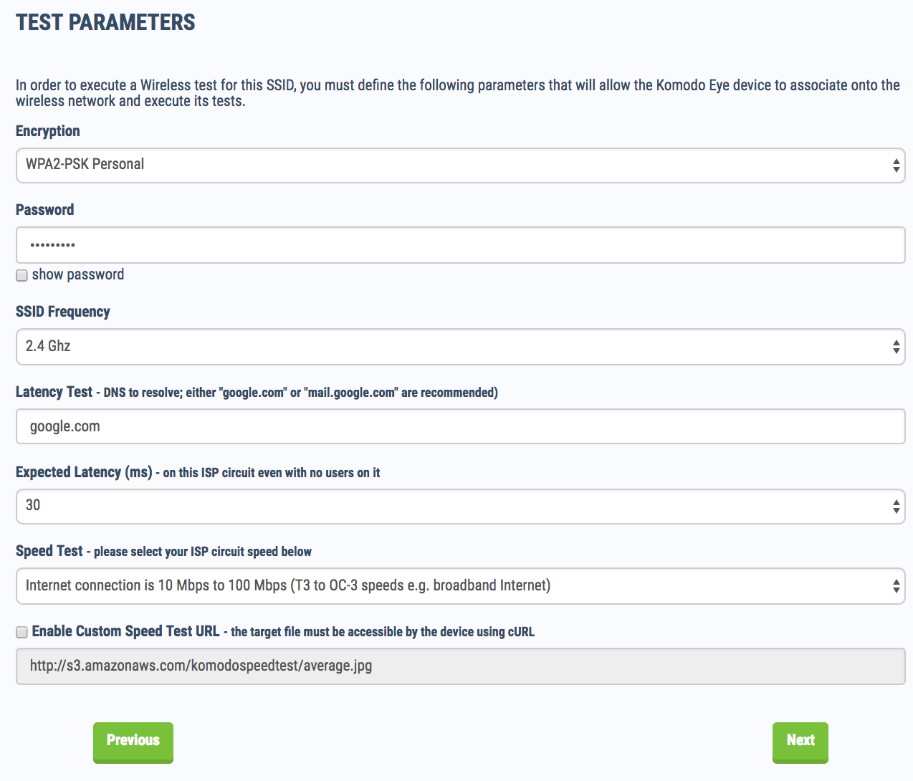
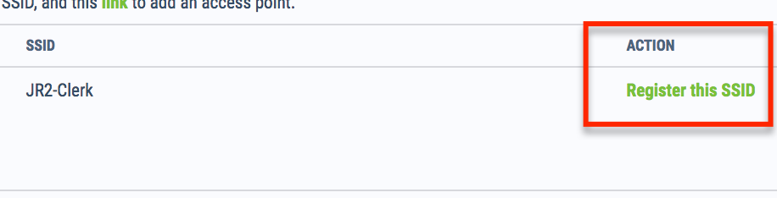
Manual device configuration
To register an SSID, find the ‘Register SSID’ link
Step through registration, ensuring the appropriate encryption type, frequency, and ping target are selected
Alarm thresholds, by default, are very lenient and can be changed any time
1

Slide 13
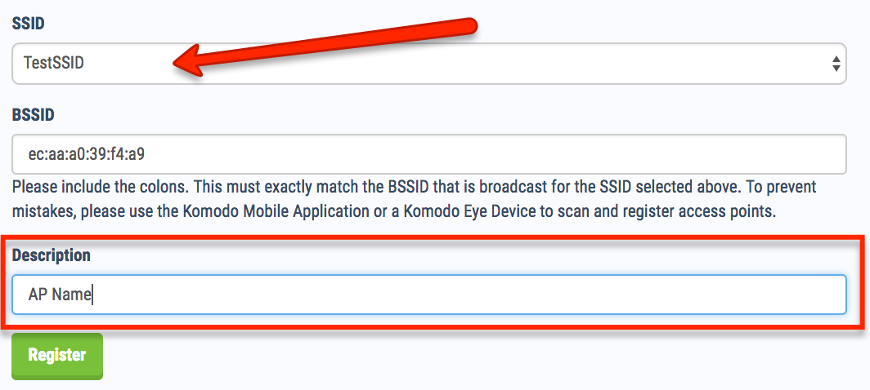
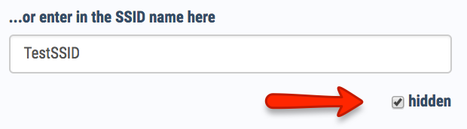
Manual device configuration
Hidden SSID configuration must be done under the Configuration -> SSID menu
Be sure to select the ‘Hidden’ radio button, and manually input the SSID name
The correct BSSID must be manually associated with the SSID through Configuration -> Access Points

Slide 14
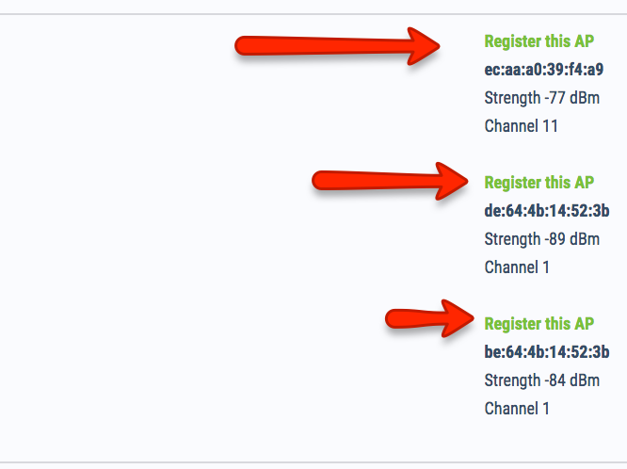
Manual device configuration
Following SSID registration, APs must be registered
From the device’s airspace scan data, select ‘Register AP’ from the list of known SSIDs
Registered SSID will appear in the assignment table at the top of the page
1

Slide 15
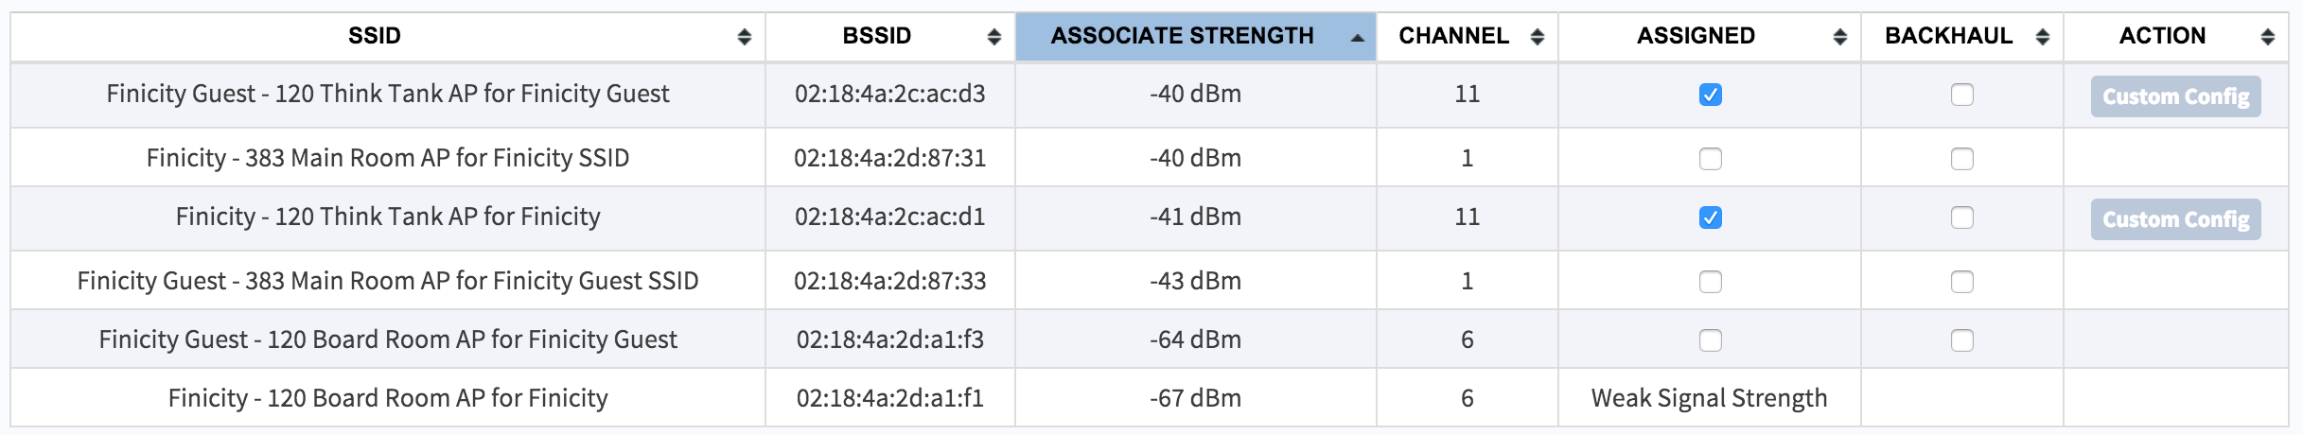
Manual device configuration
Ensure your Komodo Eyes are testing intended Access Point/SSID combination
Tests will be most effective when performed against highest signal strength
Each Komodo Eye can perform a maximum of three tests
When a Komodo Eye is not plugged into a functioning Ethernet port, ‘Backhaul’ must be selected on at least one SSID for reporting test results
1

Slide 16
Manual device configuration
You can customize an SSID’s credentials for a specific device
From device wireless configuration menu, select ‘Custom Config’
From there, select the encryption type and input the password for that building’s SSID
This is helpful for environments where multiple buildings have the same SSID name, but different passwords

Slide 17
Device Pre-configuration
Manually register a new SSID under Configuration -> SSID
Assign Eye to destination building, floor, and room
Plug Eye into Ethernet port (at the office) for 2-3 minutes to ensure complete sync
  This will download SSID configuration and location assignment
Select ‘Auto Configure’ on device card
When Eye is plugged into Ethernet and power in test environment, needed BSSIDs will be registered, and test assignments made automatically
1

Slide 18
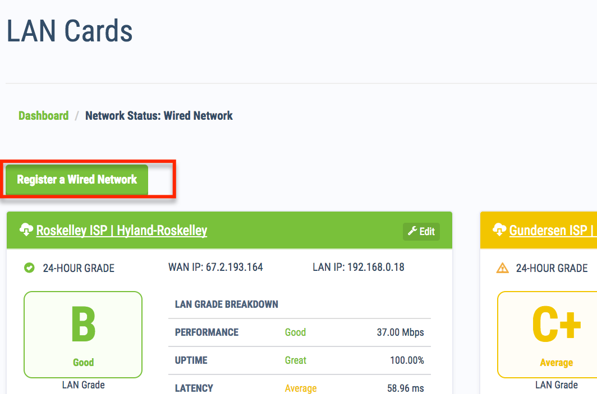
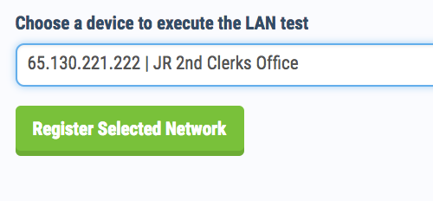
LAN testing configuration
Click Network Status -> Wired Networks, then Register a Wired Network
Currently, only one wired network per WAN IP address

Slide 19
2
Status of Organization Wi-Fi
How to review overall performance across your company

Slide 20
Organizational Wi-Fi View
Initial perspective into the health of your wireless networks
Drill into the Building Cards or SSID test result logs
2

Slide 21
Organizational Wi-Fi View
Performance broken down by organizational buildings
Colors indicate the average test results over last hour
Health at a glance of all locations in real time
NOC view displays building location and health on a map
2

Slide 22
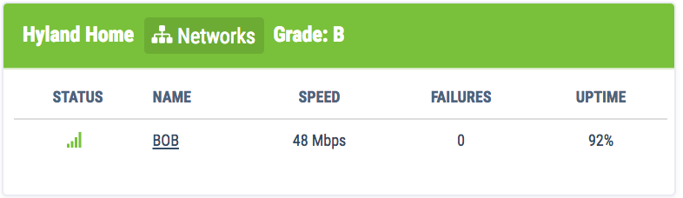
Organizational Wi-Fi View
Each building card shows all networks being tested
Status column icons change color with last hour test results
Uptime shows percentage of successful tests over last one hour
Speed is estimated circuit capacity over last testing period
2

Slide 23
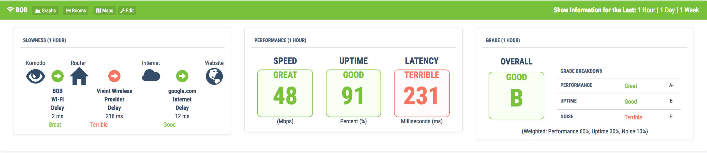
Building card review
All networks assigned to building will be given an individual card
Latency broken down by network segment
User experience broken down by Performance, Latency, and Uptime

Slide 24
3
Status of Room Wi-Fi
How to review W-Fi performance in specific areas

Slide 25
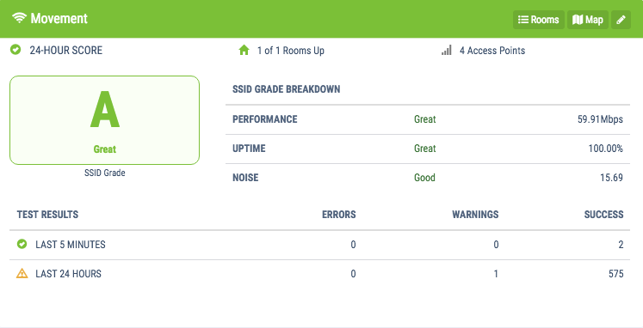
SSID Wi-Fi View
From the NOC view, select the SSID to go straight to individual test logs
From the NOC view, select ‘Networks’ to go to grade cards and then individual room performance
3

Slide 26
Komodo scorecard
Uptime
24 hour avg. percent of successful test results
SSID Grade Breakdown
Performance – 60%
Uptime – 30%
Noise – 10%
A | > 93%
B | 90% - 93%
C | 83% - 89%
D | 80% - 83%
F | < 80%
Performance
24 hour avg. available bandwidth among all users
Noise
24 hour avg. channel saturation combined with noise floor
A | 50Mbps +
B | 40Mbps
C | 30Mbps
D | 20Mbps
F | < 10Mbps
A | < 10Dbs
B | 20Dbs
C | 30Dbs
D | 40Dbs
F | > 50Dbs
3

Slide 27
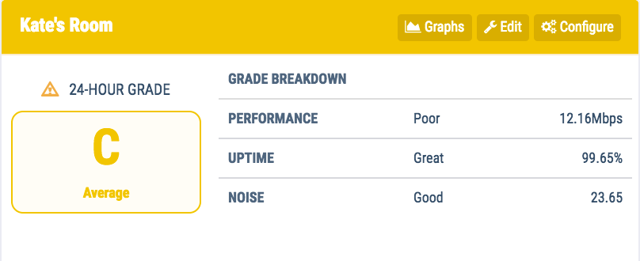
Room Wi-Fi View
Select Rooms in the Building Card header
Select Graphs for rolling 24-hour performance graph for all three metrics contributing to grade score
Last 5 Minutes/Last 24 Hours links show all errors and warnings over period. Helpful in diagnosing network issues
3

Slide 28
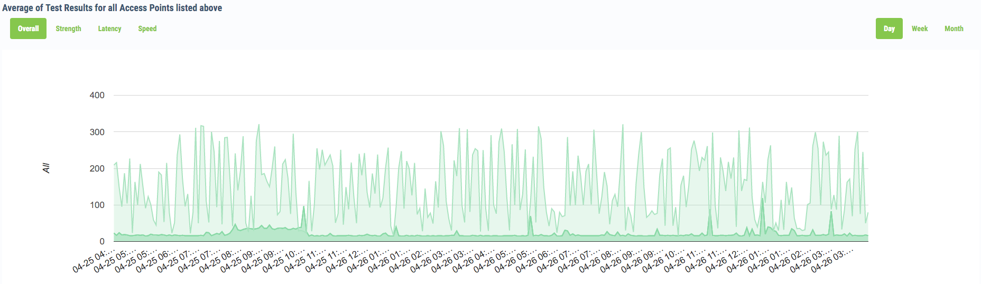
Room Wi-Fi View
Performance graph is helpful in identifying issues at specific times of day, best case performance in non-peak hours
Can toggle between Strength, Latency, and Speed
Viewable by day, week, and month
3

Slide 29
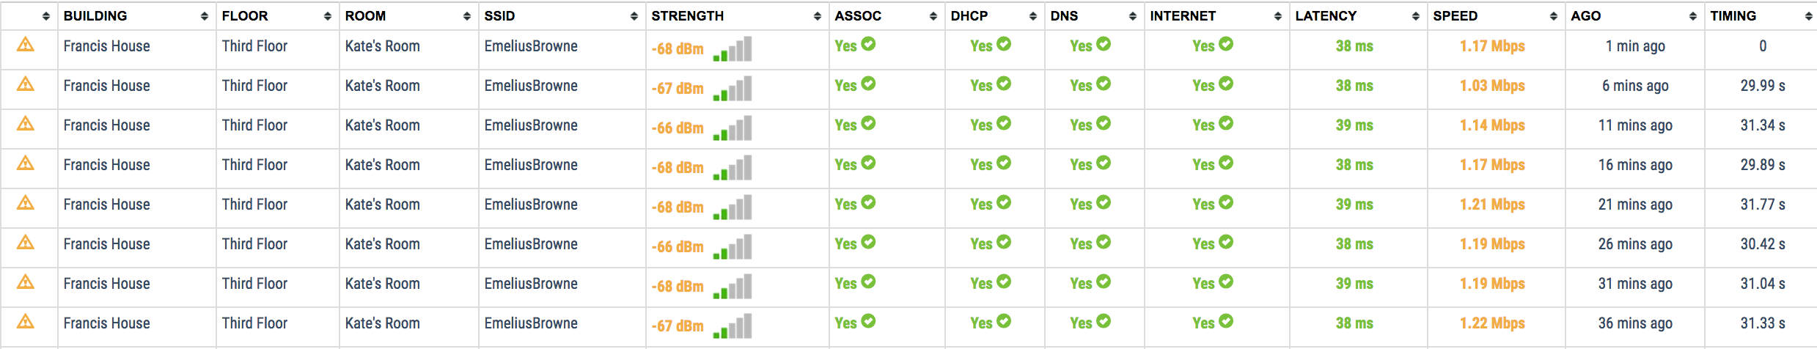
Test log review
Pop ups on Strength, DHCP, and Latency
‘Ago’ column will show complete log output

Slide 30
4
Problem Identification
Where you can look to find problems and work to resolve them

Slide 31
Problem Identification
Wi-Fi issues can arise in many areas; all areas of the dashboard provide assistance in identifying the root causes
Key areas for investigation include trend line analysis, test-by-test review, and scan data analysis
4

Slide 32
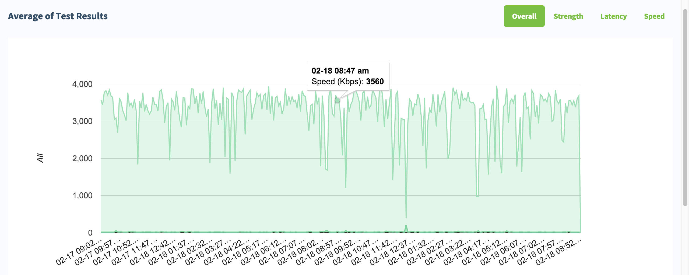
Problem Identification – Performance graph analysis
Graphs show rolling 24 hour performance by room and SSID
Toggling through signal strength, latency, and speed can reveal issues related to channel saturation, access point density, or total bandwidth needs at peak use times
Latency spikes correlate with slow speeds
Low signal strength can indicate high channel saturation, or poor access point density
4

Slide 33
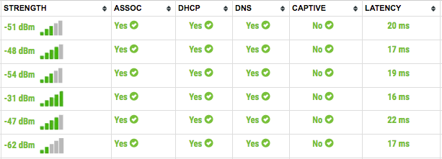
Problem Identification – test by test review
From the building card level, red, yellow or green indicators show results of most recent tests
Clicking on the network name from the building card will take you straight to the logs
From the SSID grade card, any warnings over last 24 hours can be reviewed
4

Slide 34
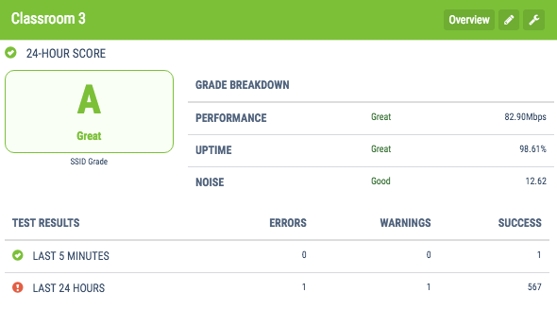
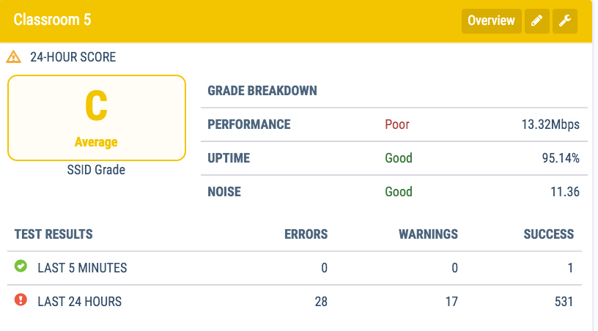
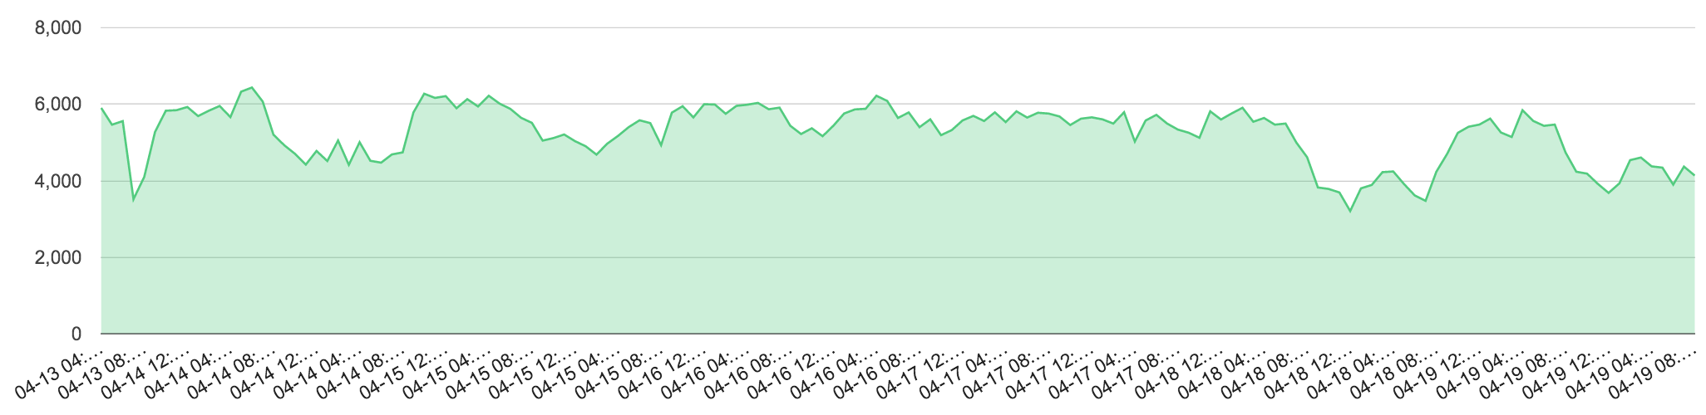
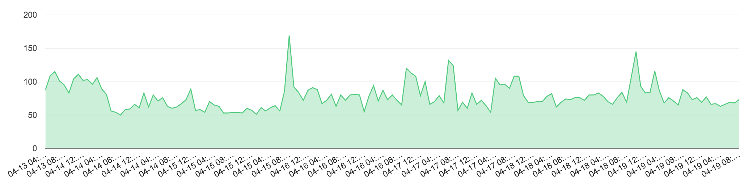
Problem identification - comparisons
Often helpful to compare metrics across areas/access points/Komodo Eyes. For example:
  If one Komodo Eye is testing two APs, are the results different between the two? Why?
  If two Komodo Eyes are testing different rooms on the same SSID, is one worse than the other? On what metrics?
  Comparing the performance graphs across a week, what are the trends day-over-day?
Midday Marks
Latency Speed
4

Slide 35
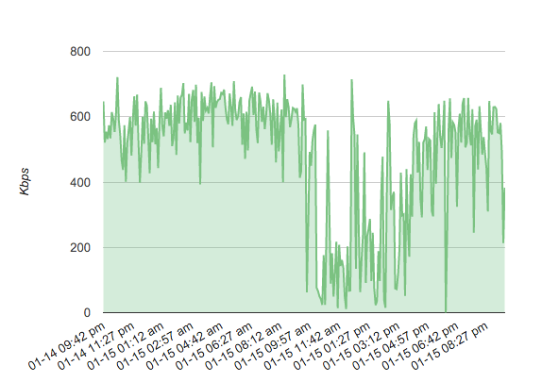
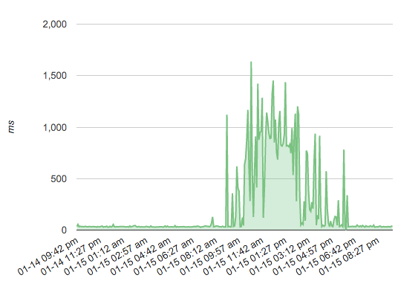
Problem identification - example
In an office building, during non-business hours, speed and latency are acceptable
During business hours, the network is severely crippled
Are the servicing APs performing as expected?
Is there enough bandwidth coming into the building?
Are the routing paths appropriate for office traffic?
4

Slide 36
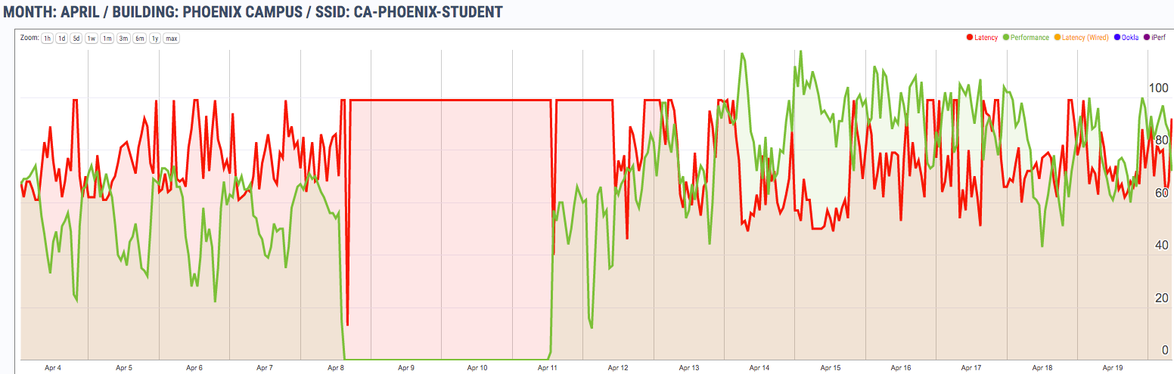
Network upgrade validation
Using custom report, view long-term timeline to identify latency and performance changes over time
  Education customer installed new network hardware
  Measured 30% increase in performance and bandwidth throughput
  Justified capital expenditures for network upgrade
Latency
Bandwidth after
Bandwidth before

Slide 37
5
Periodic Reporting
Review of historical and periodic reporting options

Slide 38
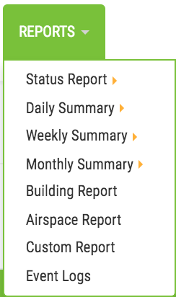
Report Access
All reports can be found in the dashboard header
Status Report – Most recent wireless test results across company
Daily Summary – 24 hour roll up of daily grade scores and hourly graph of Performance and Latency
Weekly Summary – Weekly roll up of daily grade scores and hourly graph of Performance and Latency
Monthly Summary – Monthly roll up daily grade scores and daily graph of Performance and Latency
Building Report – Listing of all company buildings and SSIDs tested with 24 hour score
Airspace Report – Summary of all Komodo Eye test assignments, APs not being tested, and possible rogue SSIDs/APs
Custom Report – Ad hoc configurable report of Latency and Performance
5

Slide 39
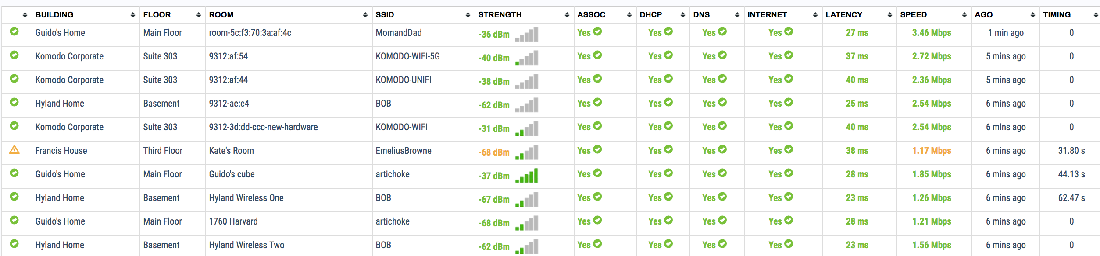
Status report
Wireless and wired status report shows most recent test cycles with key metrics
Check status report to validate recent test assignments, network changes, or Komodo Eye status
5

Slide 40
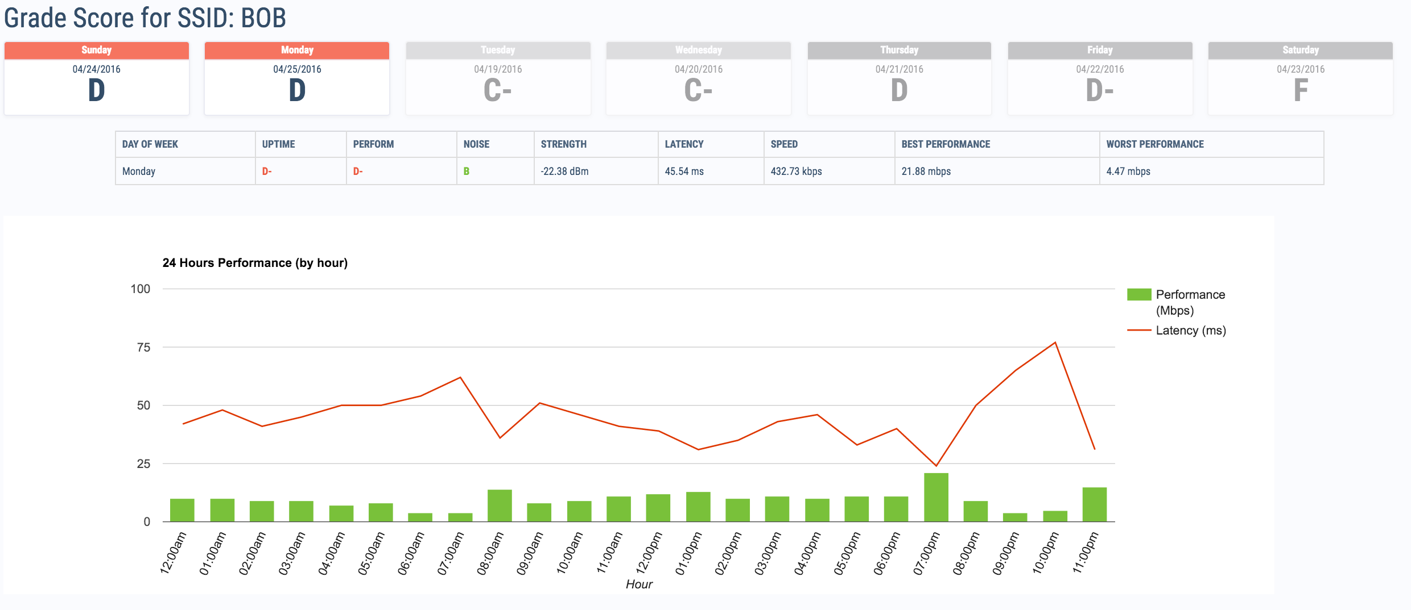
Daily summary report
Each day’s data is averaged and comparable to recent seven days’ grade scores
5

Slide 41
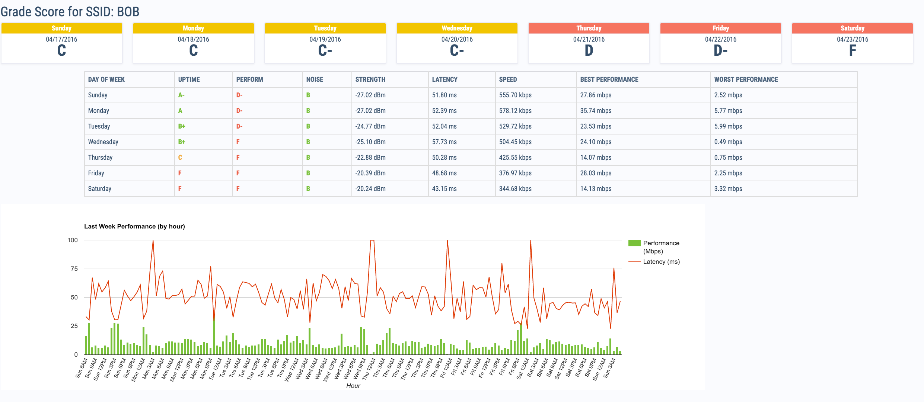
Weekly summary report
Similar to the daily report, each day’s information averaged and comparable to entire week
Additional metrics are visible: uptime, performance, and noise
5

Slide 42
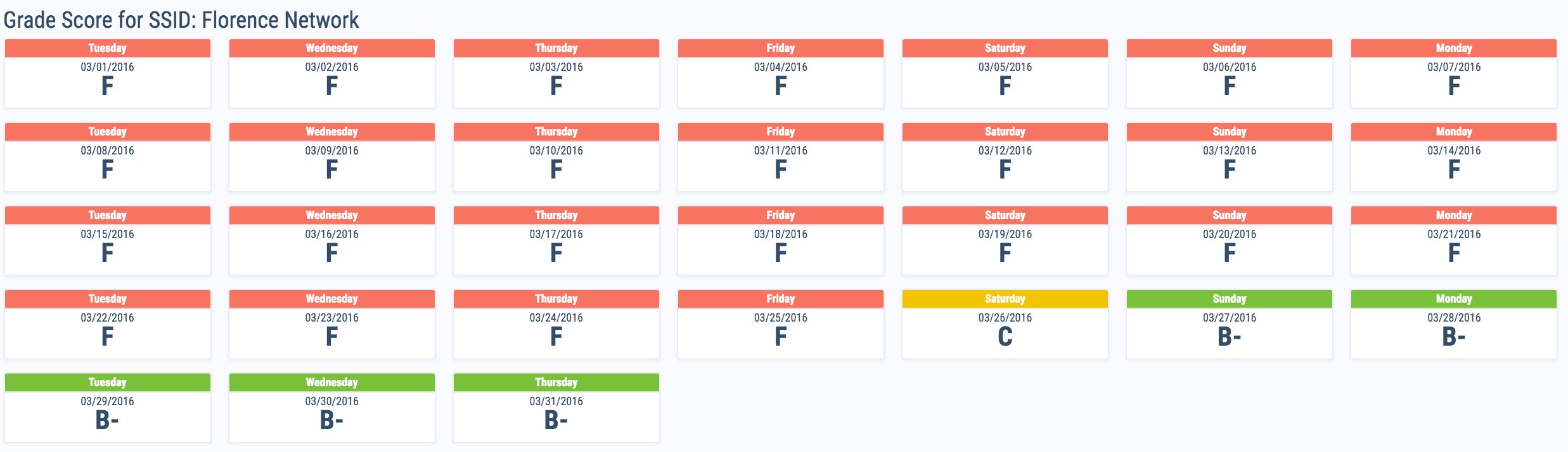
Monthly summary report
Each day’s grade score for previous full month summarized
Useful to compare network or environmental changes
5

Slide 43
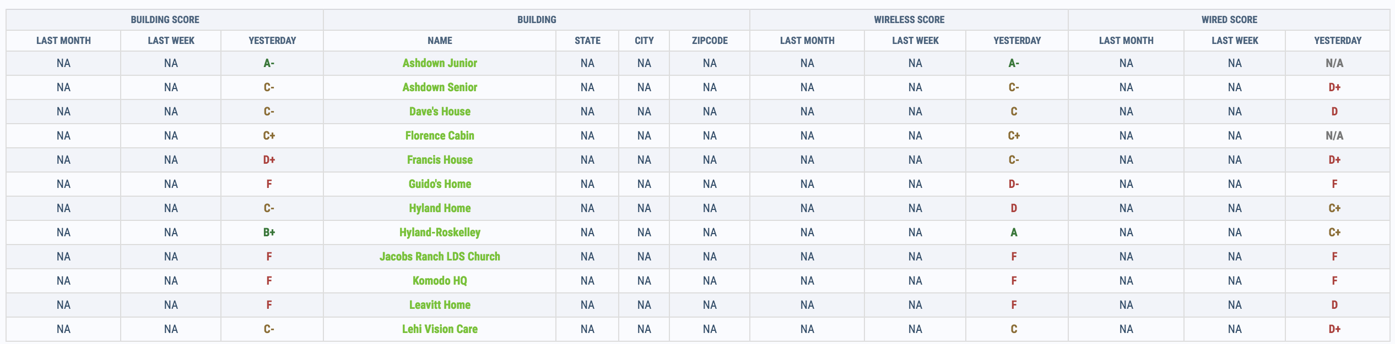
Building report
Each building under the company has summary grade score with averages for yesterday, last week, and last month
5

Slide 44
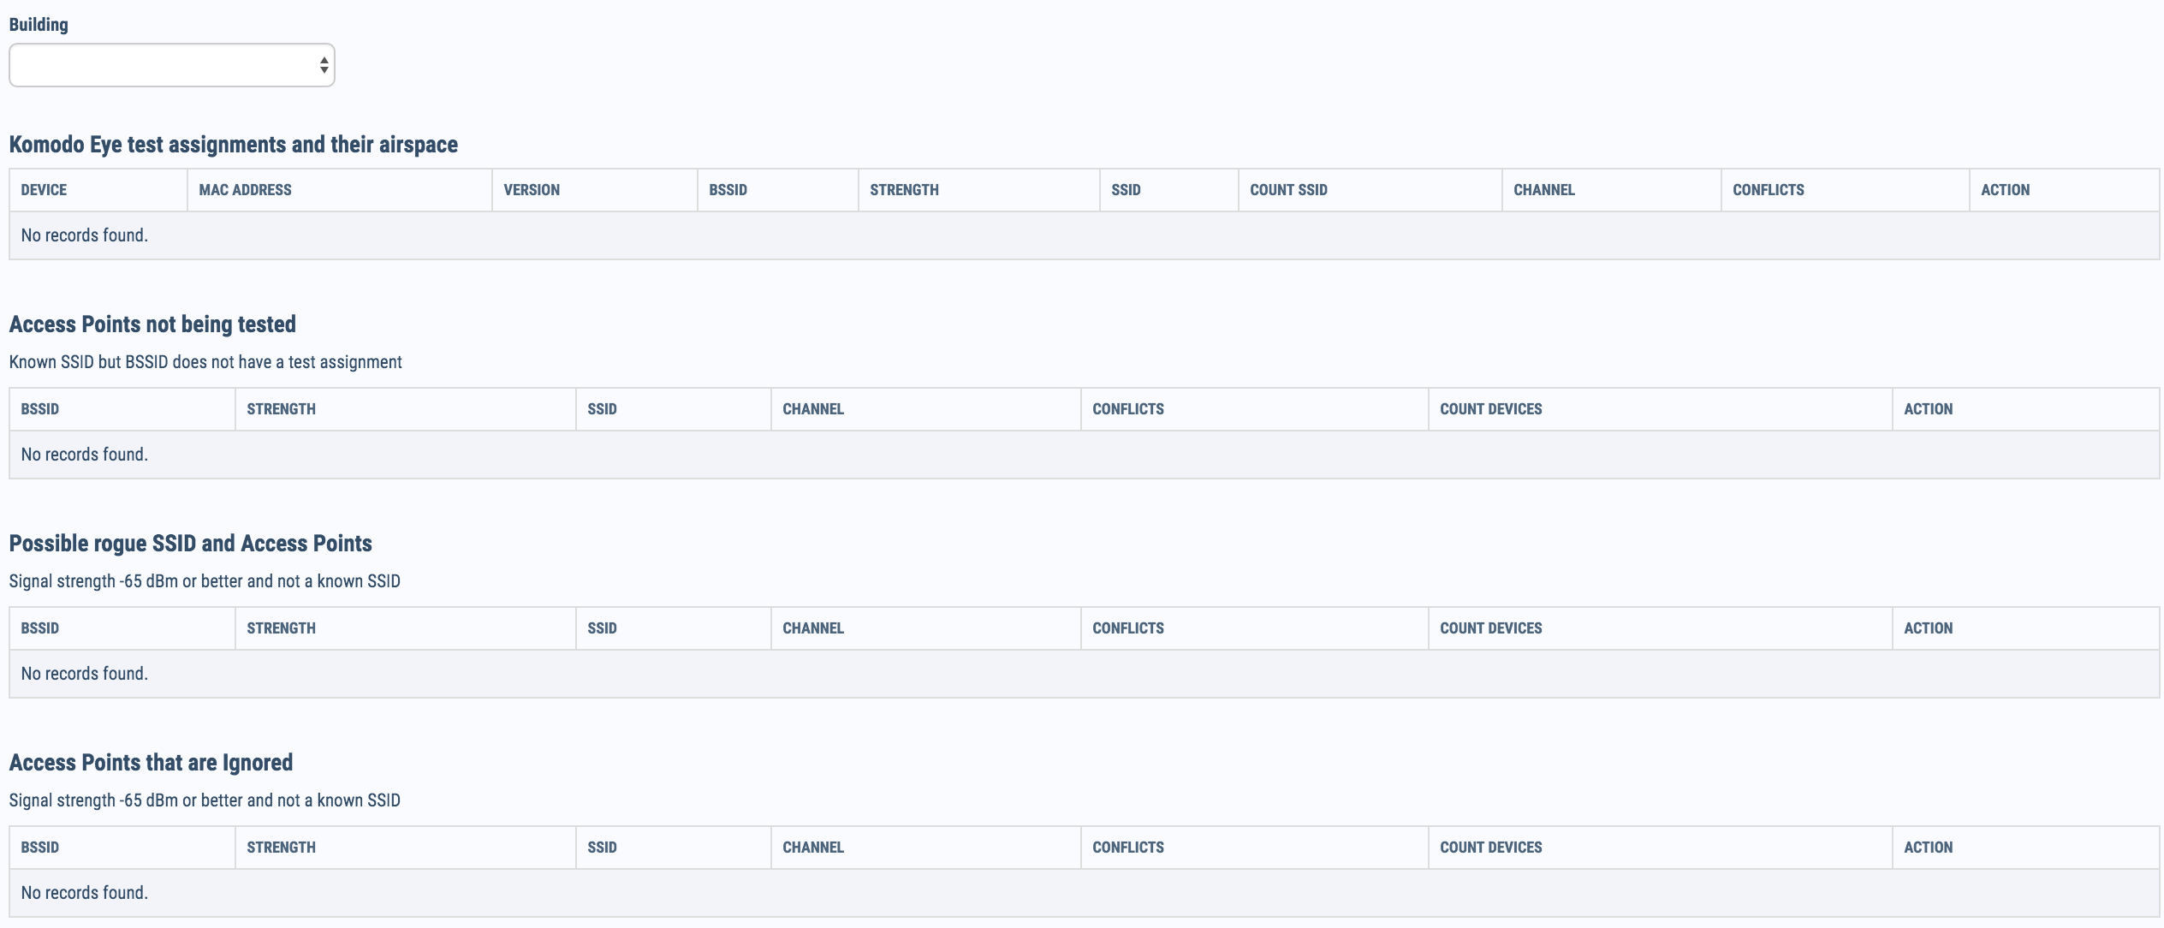
Airspace report – Komodo eye test assignments
Each deployed Komodo Eye scans its airspace each minute. The airspace report is useful to identify issues with noise, company testing coverage or potential rogue devices on network
Each Komodo Eye will show BSSID being tested, at what strength, how many other SSIDs it can ’see’, and any other SSIDs being broadcast on the same channel
5

Slide 45
Airspace report – access points not being tested
In order to fully cover your test environment, each access point should have a test assignment on a Komodo Eye
When the Komodo Eyes perform the airspace scan, APs broadcasting a known SSID are added to the database
Access Points on your network that don’t have a test are shown and marked by which Komodo Eyes can ’see’ them
5

Slide 46
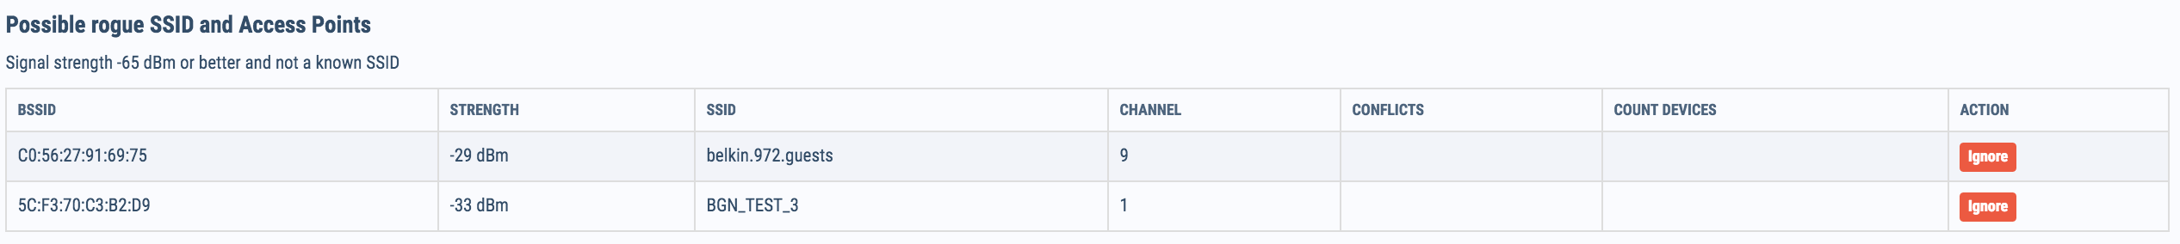
Airspace report – possible rogue ssid and access points
Any BSSID that the Komodo Eye can ’see’ is potentially within your network
The rogue APs/SSIDs are those that have not previously been identified as within the network, or ‘known’
If the SSID is known to be on a neighboring network, it can be ignored
5

Slide 47
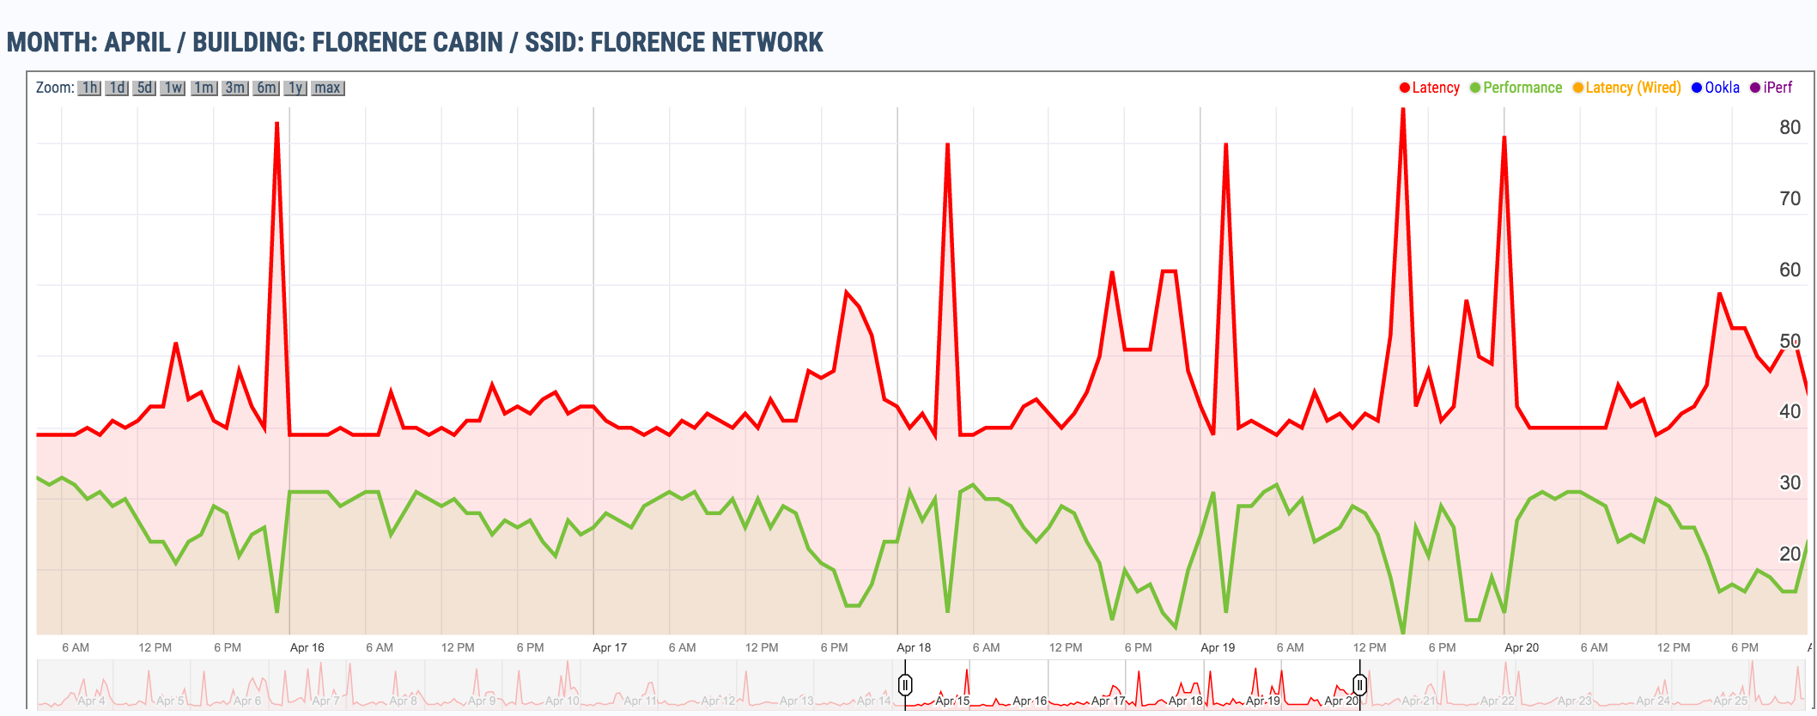
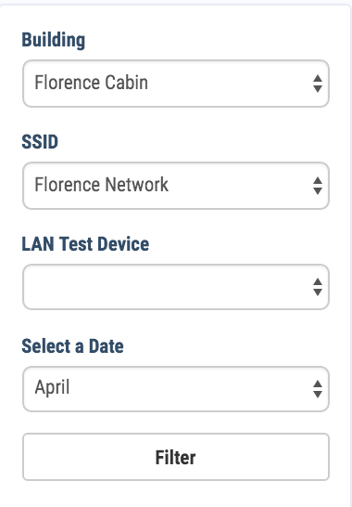
Custom report
To create a custom report, select the building, SSID, and month, then a customizable graph with Latency and Performance data is generated
Using the slider at the bottom, zoom in on a date range
Compare before, after, and during events, network changes, or potential trends
5

Slide 48
6
FAQ
Common implementation and configuration issues addressed

Slide 49
MAC address vs. s/n
MAC address that registers with panel is WLAN radio
MAC addresses increment across radios, Komodo MAC is one higher than printed LAN MAC
Devices are not tracked by S/N in the panel – this is not currently in our road map, but has noted as a requested feature
6

Slide 50
Power options
Noted lack of power outlets available at William Allen, DDS installation
Boards require 5v – 2.1amp
Laptop USB ports normally provide 5v - .5 amp, so we do not recommend plugging a Komodo Eye into a computer USB port
6

Slide 51
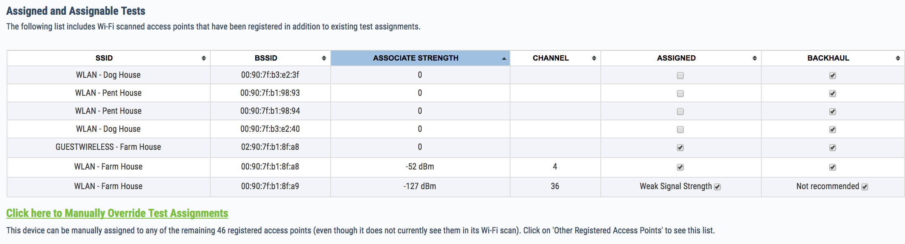
Signal Strength workarounds
If few Ethernet ports are available, set backhaul on as many APs as possible from server closet
Use Manual Assignment section from device configuration
Upcoming feature: Intelligent Backhaul
6

Slide 52
Firewall and AP Controller Issues
If a device is plugged into Ethernet, but will not heart beat, it may be blocked by firewall – whitelist Komodo servers
  All outbound traffic for heartbeat is over 80/443
  Web1 69.168.91.35
  Web2 69.168.72.11
  Web3 69.168.91.36
  Web4 69.168.72.12
  Load Balancer 69.168.91.37
  Load Balancer 69.168.72.14
Occasionally, packet filtering will delay or block heart beat from reaching Komodo servers
6

Slide 53
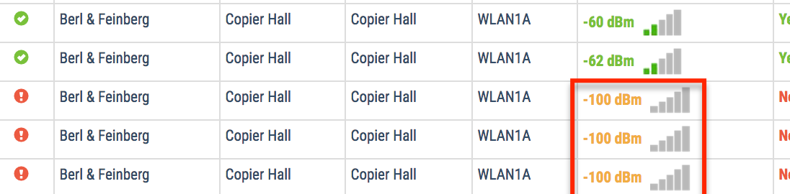
Firewall and AP controller issues
If a device is plugged into Ethernet, and will heartbeat, but not associate with the AP, it may be blocked by the AP controller security policy
  White list device’s WAN MAC address AND WLAN (Komodo) MAC address
-100 dBm is error code for no association or authentication
6

Slide 54
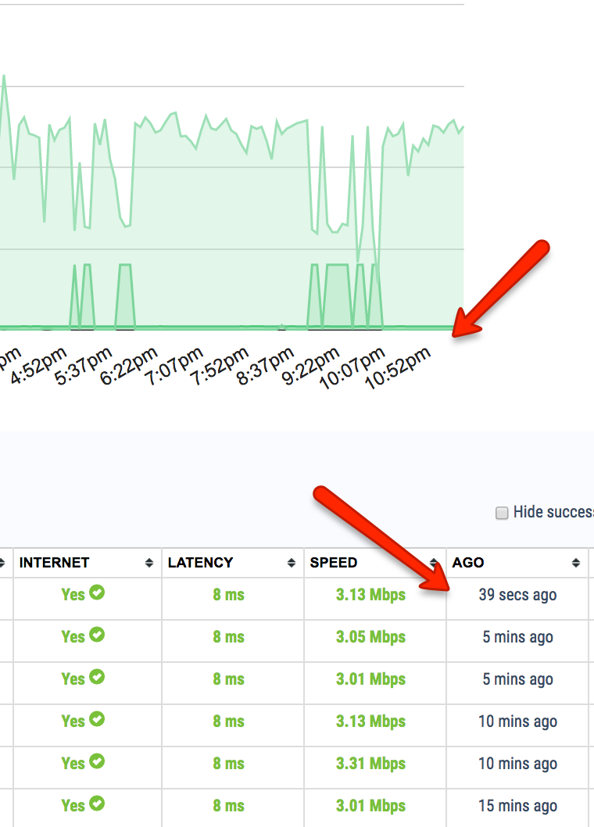
Enable NTP protocol
At boot up, devices will send an NTP request for current time
If NTP is blocked at firewall, performance graphs and ‘Ago’ column will be out of sync
6

Slide 55
Cameron Francis
VP Sales and Marketing
(801) 673-3133
cameron.francis@komo.do

